Slide 1


UNI THRIFT
Presented by :
T.Delight
Emre Yasar, Esila Alkan, Onur Kahraman, Mert Cetin

Slide 2


The Problem
High Costs: Textbooks and academic materials are expensive and used for short periods.
Waste: Many usable items (books, electronics, furniture) are discarded by graduating students.
Trust Issues: Public marketplaces (like Facebook or Craigslist) lack security and verify identity.
Inefficiency: No centralized platform exists strictly for our campus community.

Slide 3
The Solution
Our Solution: UNI THRIFT
Exclusive Community: A platform accessible only to verified university students.
Circular Economy: Promotes reusing items instead of buying new ones.
Cost-Effective: Students save money on buying and make money by selling.
User-Friendly: A modern, mobile-responsive web application designed for Gen-Z.

Slide 4
Project Scope (SRS Mapping)
UC001: User Authentication:
UC002: Post New Item
UC003: Search & Filter
Secure Login and Registration flow using LocalStorage.
Dynamic filtering by category (Textbooks, Electronics) and keyword search.
Interface to list items with details (Title, Price, Category, Image)
UC004: Chat System
Real-time messaging simulation between buyers and sellers.

Slide 5
Technical Implementation
Frontend: HTML5 & Tailwind CSS
Why? For a modern, responsive, and clean UI/UX.
Application Logic: Vanilla JavaScript (SPA Architecture)
Feature: Single Page Application behavior for smooth transitions without reloading.
Data Persistence: LocalStorage API
Feature: Simulates a database; user sessions and posted items remain saved even after refreshing the page.
Key UX Features:
Toast Notifications (Success/Error feedback).
Smooth Fade-in Animations.

Slide 6
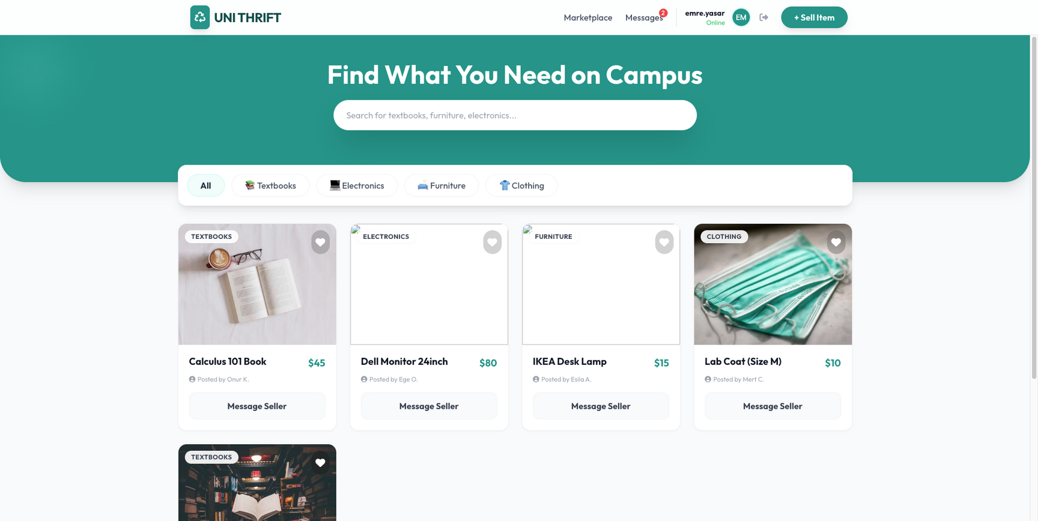
LIVE DEMO
Live Prototype Demo

Slide 7
CONCLUSION
Summary: We successfully delivered a functional MVP (Minimum Viable Product) meeting all SRS requirements.
Future Improvements:
Backend integration (SQL Database).
Payment gateway integration.
Mobile App (React Native).
Thank You!

